Slide 1
Finding Optimum Locations to Open a Restaurant in London
Samer Bachir
12th November 2020

Slide 2
INTRODUCTION
The restaurant business in London has consistently been growing. The number of restaurants now number almost 20,000. However significant changes to the makeup of restaurants in the capital continue to occur.
Millennials are a big driver in business change. It is expected that more organic ingredients and more vegan and vegetarian options will become increasingly important.
The business problem I have decided to solve is to determine the best location to open a vegan or vegetarian restaurant in London.

Slide 3
Business Problem
The restaurant business is incredibly competitive and it is estimated that almost 60% of independent restaurants fail within 3 years.
Main factors for failures are as follows:
High concentration of restaurants in a given locality and saturated market.
Owners skilled at cooking but not at business.
Owners inability to raise capital.
Owners inability to conduct proper marketing.
Locating a restaurant in the wrong demographic or where there isn't enough footfall.
Owners having to work too many hours and having not the quality of life they originally planned for.
Not providing a full customer experience that appeals to all the senses.
Lack of differentiation in brand concept with other nearby restaurants.
Paying too high a rent for the revenues that could be reasonably achieved.

Slide 4
Method
The following location factors were selected for the assessment:
Excellent transport links.
Not having a high concentration of competing restaurants nearby.
Having many complementary businesses nearby.
Having high local population densities nearby.
Data sources:
Foursquare.
Office of National Statistics.
Transport for London.

Slide 5
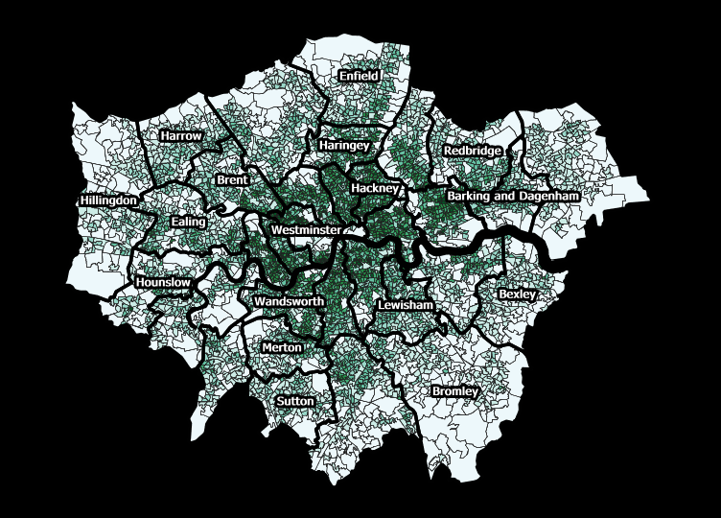
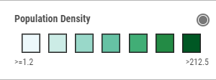
Data Analysis
Population Density:
Greater in central and western parts of London.
Better transport links north of the river have meant a greater distribution of the population live in these areas.

Slide 6
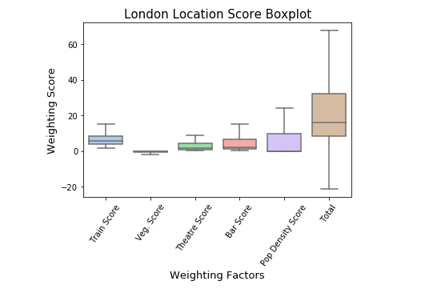
Statistical Analysis
Distribution and weighting was controlled to ensure mean value of around 10.
Box Plot shape of each factor can be seen to be relatively similar.
However, there remained a significant number of outliers that skewed final results.

Slide 7
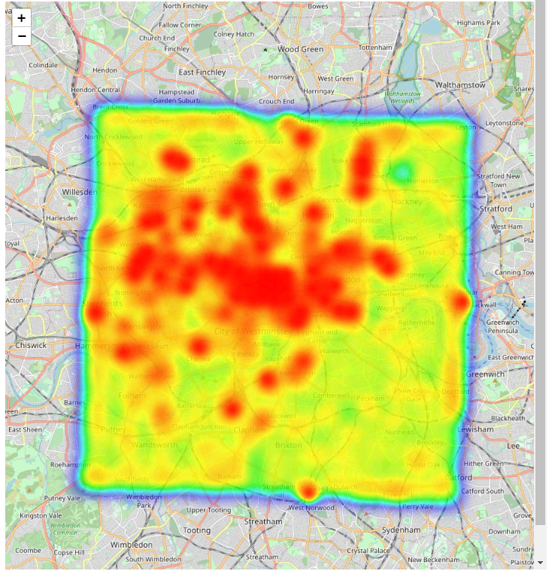
results
Folium Heat Map package was used for visualisation of results.
The warmer colours represent the more optimal locations.
Can be clearly seen that the central and westerns parts of London are particularly attractive locations.

Slide 8
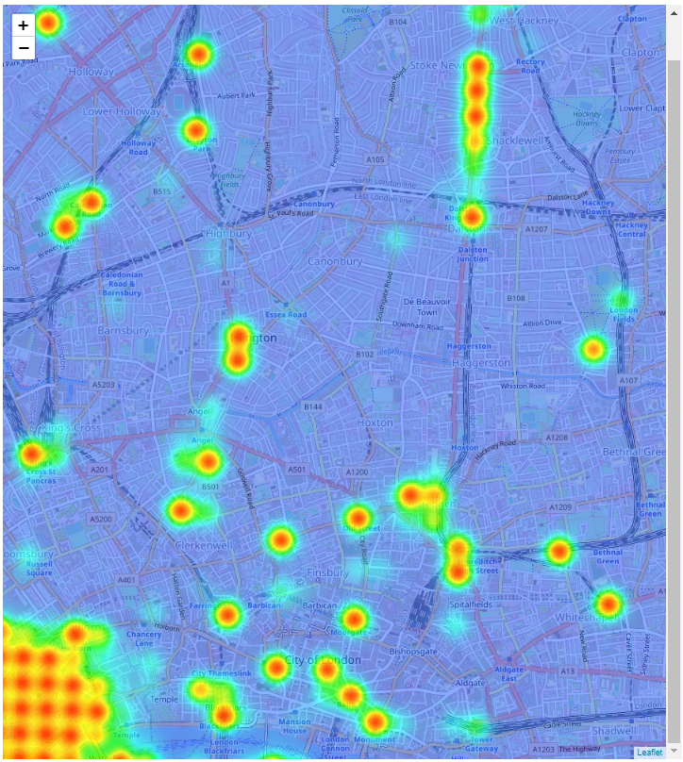
Results
Folium Heat Map package is interactive and can be zoomed into any area.
It can be seen that favourable restaurant locations are close to stations and areas of town near many attractions.
It also was noted that the population density seemed to have a more broader and less spiked effect on the results.

Slide 9
Recommendations:
The locations selected from this assessment should be studied further to determine the accuracy of assessed factors and also ensure all the possible criteria are included in the final evaluation.
Detailed footfall information should be purchased from Foursquare over a recent historical period and used as the dependant variable on which to base this assessment.
Future work should utilise machine learning techniques such as regression analysis and possibly neural network based methods so as to obtain a more accurate and testable algorithm.
The rental expense of individual areas should be factored into a future assessment.
Further assessment of areas away from central London that have been assessed as optimal should be looked at in further detail to determine if there are potential good value opportunities.

Slide 10
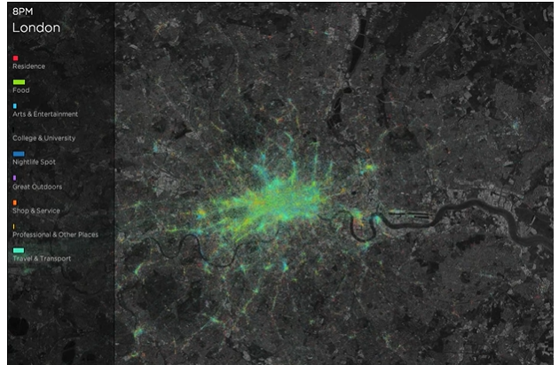
Conclusions
Although, the logic and criteria selected appear sound, this hasn’t been tested. This would make this assessment a difficult sell to clients.
Data does exist that can improve this assessment - e.g. FourSquare has data on what Londoners are doing throughout the day (snapshot opposite).

